Slide 1
Demo of The Chat App
By-
Saumya Shikhar Mishra
Shivang Singh
Gaurang Gupta
Raj Agarwal
Kshitij Ingle

Slide 2
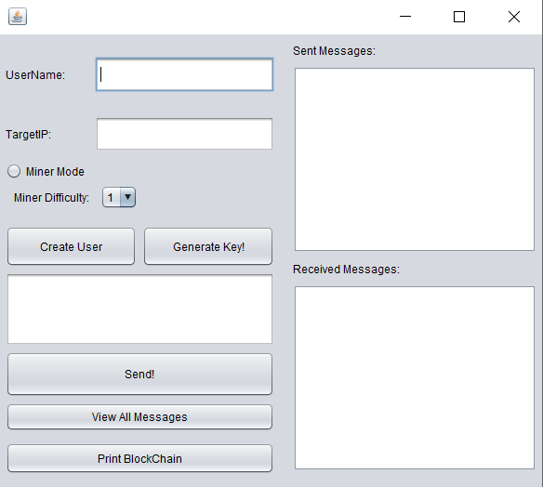
There are two modes for operation, miner mode and normal mode.
There must be at least one miner, otherwise there would be no blockchain created as there would be no blocks mined.
The difficulty would determine how many initial zeroes in hash should be there. Difficulty of over 5 is recommended, otherwise mining blocks becomes too easy.
Since having both miners would cover the sub case of having one miner, we would select miner on both users.
The app does not require two users necessarily. If you have only one system, just enter your own IP Address in Target IP, and the app would work perfectly. You would be both the sender and the receiver of the message. Just keep the difficulty low, otherwise the same user would have to mine 2 blocks.

Slide 3
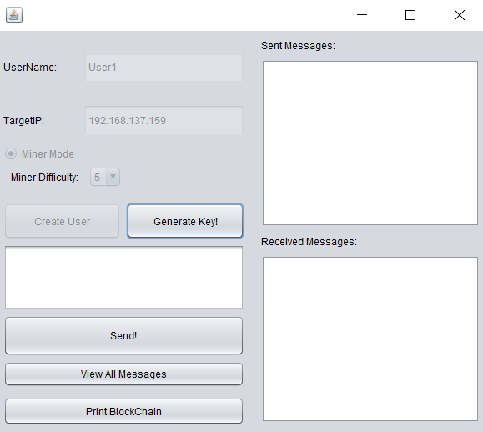
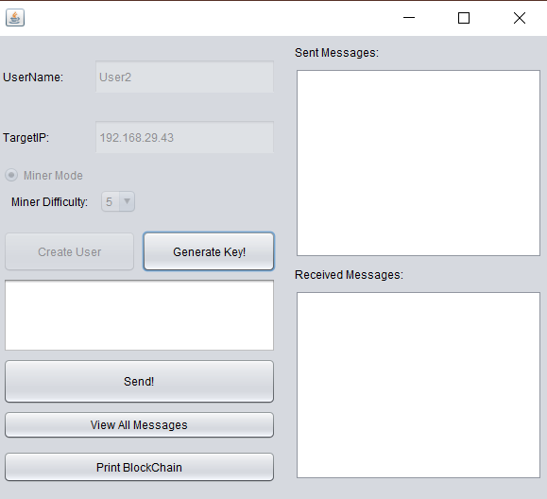
Note: Make Wi-Fi hotspot through one laptop, and connect the other to this Wi-Fi hotspot.
Creating User1. Enter the details. Click on “Create User”
Creating User2. Enter the details. Click on “Create User”
Click on the button “Generate Keys”. Both users will get each other’s public keys and their username.

Slide 4
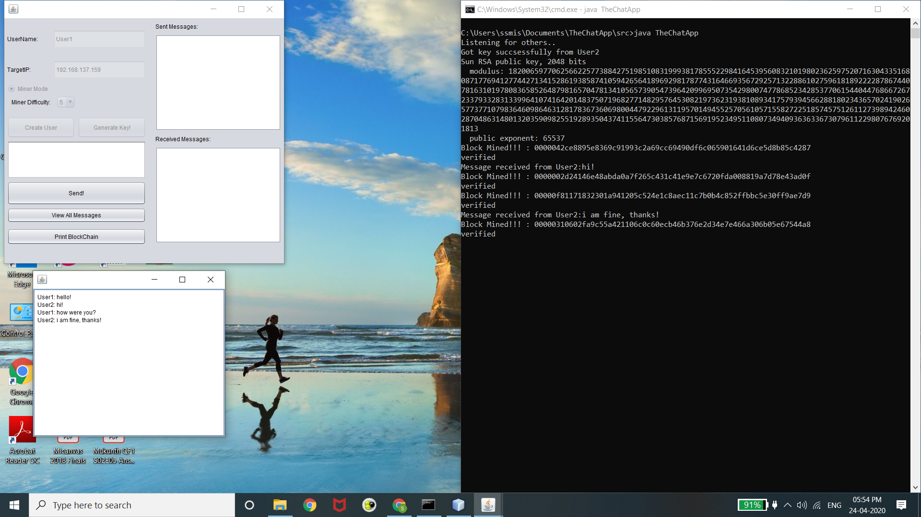
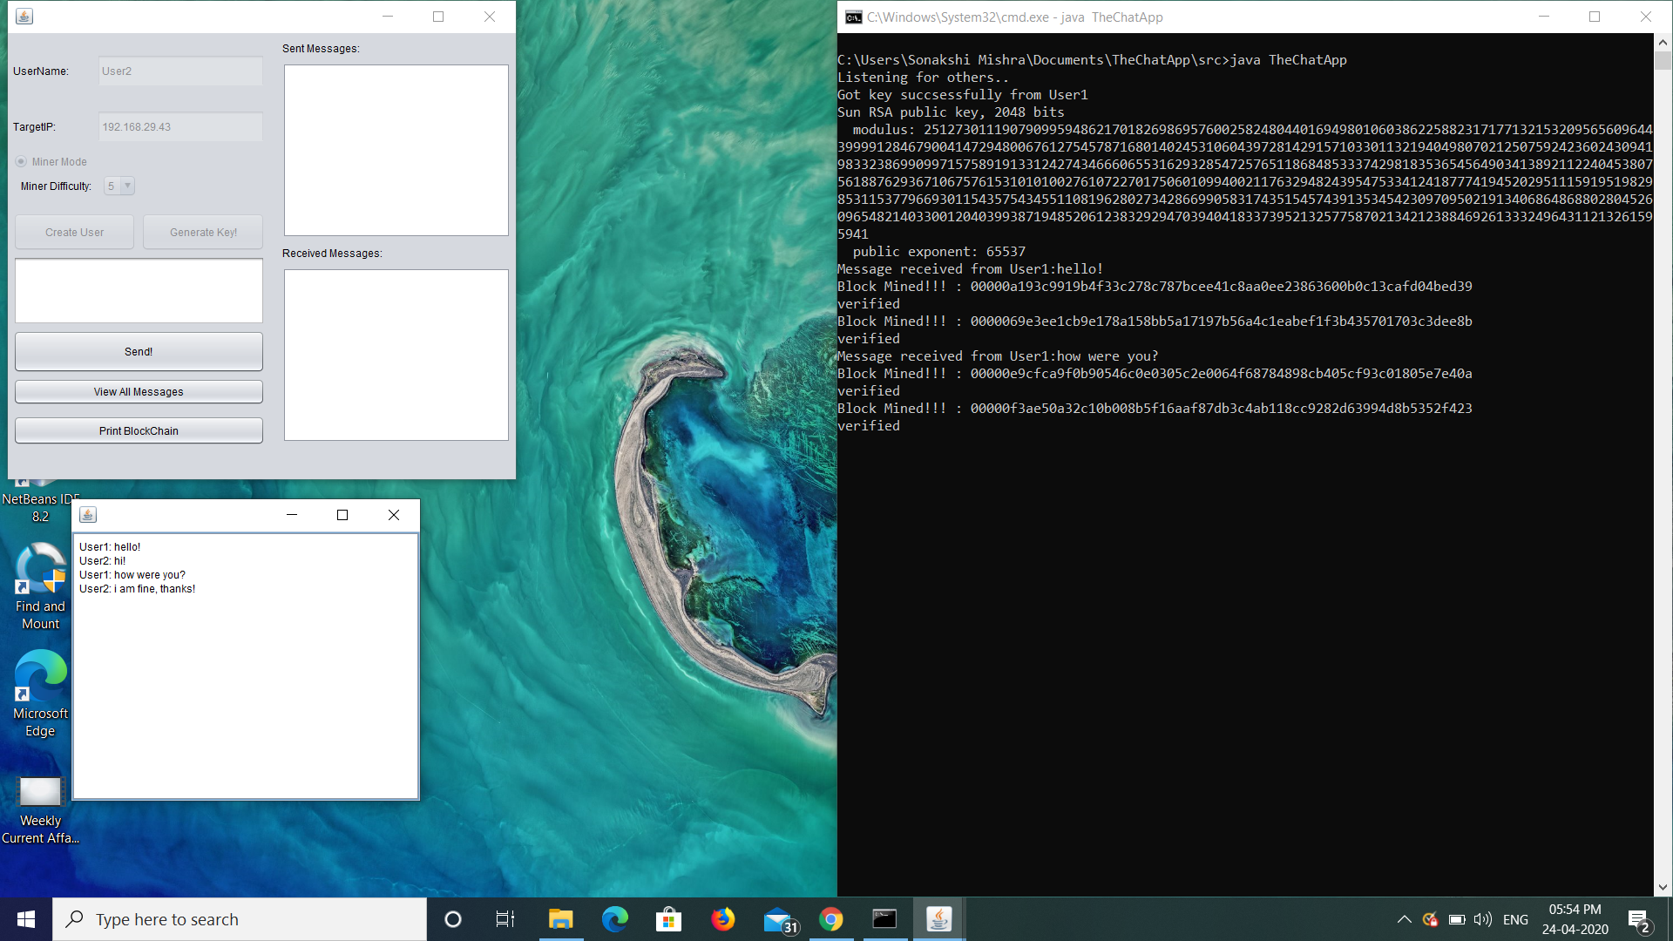
Sending messages.
User 1 (Laptop 1)
User 2(Laptop 2)
This screenshot is after sharing few messages. Note that the time is same in both the laptops.
The purpose of the above images is to show the simultaneous working of the app on two system.
Both of the above shown images are enlarged for better view in the next slide.

Slide 5

Details:
User 1
User 2
The live chat area is working fine in both cases. Note that updating live chat area may take 1-2 seconds due to the blocks being mined. It is advisable hence to take a few seconds gap to exchange the messages, so there in no unnecessary load on the system while mining.

Slide 6
Details:
User 1
User 2
Every time a message is exchanged, both users mine the block (both being miners in this example). Since there are 4 messages, there are 4 blocks mined by each of them (Transaction limit per block is kept as 1 for simplicity). Note how the blocks mined by both User 1 and User 2 are different (Clashing blocks). This is expected. But later we’ll see how they still share a common blockchain, and only 1 of the 2 blocks is added for each of the 4 messages.

Slide 7
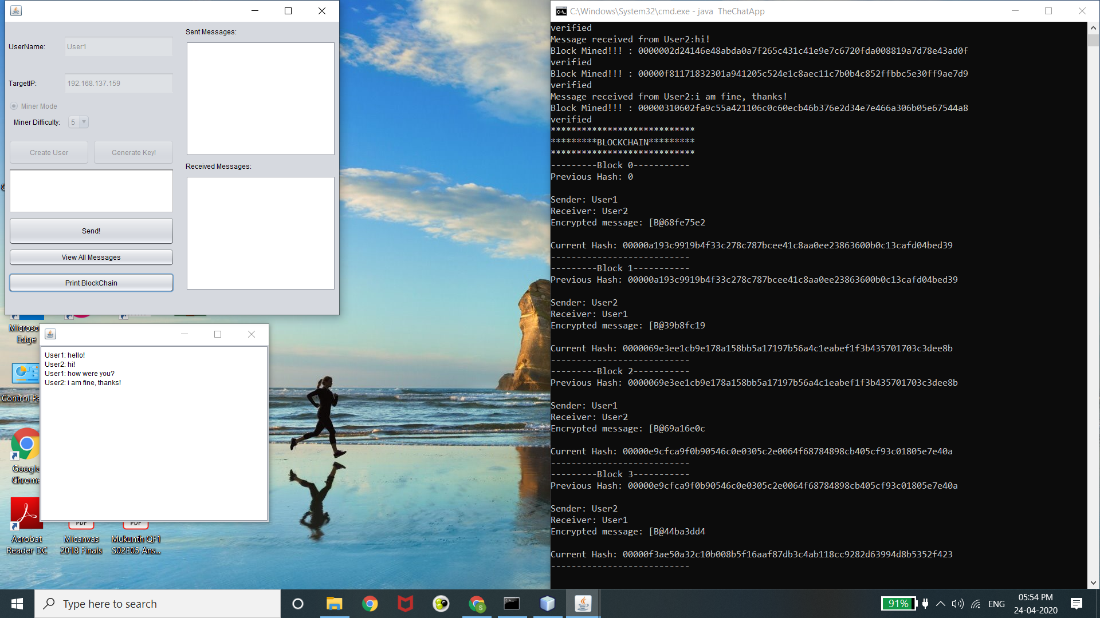
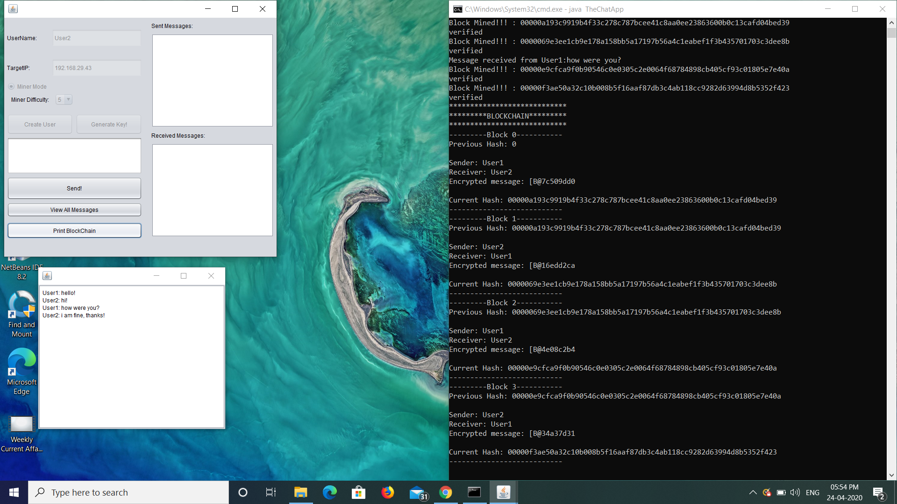
Displaying blockchain.
User 1 (Laptop 1)
User 2 (Laptop 2)
On clicking “Print Blockchain”, the blockchains are displayed on the terminal.
Just depicts the simultaneous working on both the systems(nodes).
For enlarged view, refer to the next slide

Slide 8
Displaying blockchain: Note that they share the same blockchain but independently.
User 1 (Laptop 1)
User 2 (Laptop 2)

Slide 9
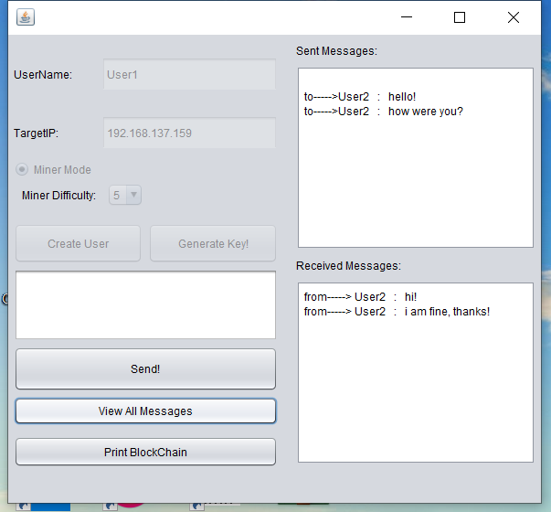

Accessing Blockchain: viewUser()
User 1 (Laptop 1)
User 2 (Laptop 2)
On clicking “View All Messages”, all the messages (received and sent) for a user are displayed.

